Slide 1
Technical writing style

Slide 2
Introduction
While structuring, it is very important to pay attention to the writing style.
A well written technical document is one which is easily understood even by the lay man.
Whenever you buy any new gadget, be it a camera, juicer, tape recorder, or for that matter, even a pack of medicine from a pharmacy, you first read the literature that is kept along with the product.
Now, if it contains all jargons and is written in a complicated language, it would be difficult for you to understand and use the product.
Hence, it is essential for you to develop a simple and lucid style of writing if you want to become a technical writer.

Slide 3
Objectives
After studying this unit, you will be able to:
write technical documents in a concise style.
construct unambiguous and clear sentences.
avoid commonly made mistakes while writing.
recognize British and American English.
use consistent style in technical documents

Slide 4
Concise Communication
While writing a technical document it is essential that it be concise and direct.
The longer the document, the more difficult it is to use, for the obvious reason that it takes more of the reader’s time.
But you should write it in such a way that it gives justice to conciseness, clarity and comprehensiveness.

Slide 5
Clarity and Precision
Whenever you write a technical document, be clear about what you want to say and say it clearly.
Use short, simple words and language to relate whatever you want to tell.
Use concrete words – two words in English will have similar meaning – in such cases, use the word which is commonly understood.
E.g.: if you use the word ‘house’ and it conveys the meaning that you intend, don’t use the word ‘residence’ which will make the message more complicated.
Avoid long winded sentences (running into five lines and more).

Slide 6
Spare your reader the tedious task of understanding the document and try to make smaller sentences.
To make the document clear, break it into different paragraphs when you have to discuss more than one main point.
Finally, you have to understand that writing a good technical document involves a lot of practice which will gradually enable you to be an effective writer.

Slide 7
American and British English
American English is the form of English written and used in America.
It includes the dialects used within the United States of American.
British English is the form of English written and used in United Kingdom. It includes the dialects used within the United Kingdom.
The difference between the English used in Britain and United States, is mainly found in the pronunciation and vocabulary, which includes spelling.

Slide 8
American English has been a fertile source of new words and usages.
Others include buzz words and expressions such as blueprint for success and lifestyle, slang and informal usages.

Slide 9
Word ending in ‘-our’ became ‘-or’: color, armor, neighbor
British ‘-re’ became ‘-er’: meter, liter, center
British ‘double l’ became single: traveling
Some British ‘single l’ became double: skilful became skillful, rationalizing the idea that ‘skillful’ is derived from the word ‘skill’.
British ‘-s’ became ‘-z’: rationalize, terrorize
Other words were spelt the way they were pronounced: cheque became check, programmed became program, tyre became tire, pyjamas became pajamas, bonnets and boots became hoods and trunks, lifts became elevators We should also be careful while writing the date.
The difference in short form date order can lead to misunderstanding. For example, 02/03/08 could mean either March 2, 2005 (if read as British format), 3 February 2008 (if seen as in American format).

Slide 10
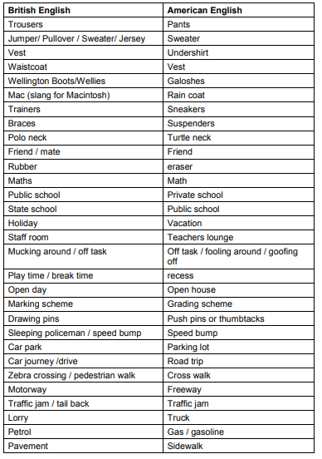

Slide 11
Style Manual
A style guide, or style manual, is a set of standards for the writing and design of documents, either for general use or for a specific publication, organization or field. The implementation of a style guide provides uniformity in style and formatting within a document and across multiple documents.
Technical writing, like other types of writing, has over the years developed a style of its own.

Slide 12
This has been accepted globally in order to keep up with the consistency and precision in word usage, which is of paramount importance in communication.
It is usually a cause for concern when your readers find instability in the usage of certain spellings, or fonts.
Readers are quick to find when you confuse ‘alter’ and ‘altar’, or write ‘born’ instead of ‘borne.’
So, a style guide or style manual is adopted by the company to maintain consistency in the writing. Here, we will focus on some of the general matters that require being uniform throughout the document or between two documents of the company.

